Slide 1

Time series data analysis and forecast methods
Lecture 9
Advanced methods of time series forecast and data assimilation

Slide 2

Lecture map
Advanced methods of time series forecast
Time series forecast with SSA method based on linear recurrence forms
Time series forecast with SSA vector method
Forecast with NAR and NARX neural nets
Forecast correction with neural nets
Data Assimilation technique for forecast correction based on new observations
Ensemble Data Assimilation techniques

Slide 3
Part 1. Time series forecast with Singular Spectrum Analysis

Slide 4
Forecast with SSA
In SSA method we receive the set of vectors, received from the sliding window L;
These vectors generate the trajectory matrices, for which we can establish the Linear Recurrent Formula (LRF);
With these LRF the forecast scheme can be reconstructed;

Slide 5
SSA forecast technique
Input data:
Initial time series
Number of samples N
Window of size L
Number of predicted/forecasted points M

Slide 6
SSA-R forecast technique
Define the linear space with number of dimensions;
This linear space is defined by its orthonormal basis , but the resulting forecast is independent of the concrete basis.

Slide 7
SSA forecast technique
With SSA method we can create the trajectory matrix for the initial time series:
Calculate the matrix
This new matrix is the orthogonal projection of X to the linear space

Slide 8
SSA forecast technique
New matrix can generate a new time series;
Let – vector from a linear space;
The last coordinate of this vector is a linear combination of previous components:

Slide 9
SSA forecast technique
Let
where – the last component of a basis Р.
Then the array of weighting coefficients is
and does not depend on initial basis Р.

Slide 10
SSA forecast technique
With this array we can forecast the time series data G as follows:

Slide 11
Vector SSA-forecast
Input data:
Initial time series
Number of samples N
Window of size L
Number of predicted/forecasted points M

Slide 12


Vector SSA-forecast

Slide 13
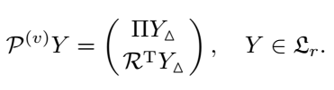


Vector SSA-forecast

Slide 14
Another SSA-forecast
Analyze the time series with SSA method, but only partially: without diagonal averaging;
Add to the initial time series one new random observation within the reasonable interval:

Slide 15
Another SSA-forecast
Decompose this new time series length of N+1 with SSA method, but do not estimate any parameters – use the previous estimations from N length initial time series;
Regroup and do a diagonal averaging for a new time series to reconstruct the data;
Important note, there is no new estimations or grouping for a new time series.

Slide 16
Vector SSA-forecast
After averaging procedure we will get a new time series with the same N initial observations and the last observation with pre-forecast;
For an accurate N+1 observation forecast we need to repeat the previous steps until the forecast value stops to change;

Slide 17
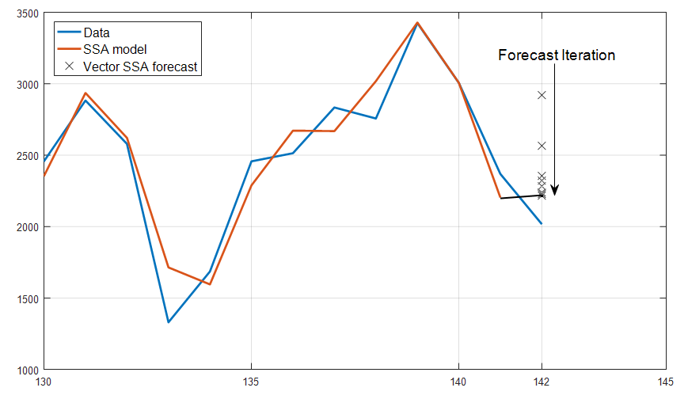

Slide 18
Part 2. Forecast with ARTIFICIAL neural networks

Slide 19
p₁
w₁
p₂
p₃
+
n
f
y
:
b
p_{k}
w_{k}

Slide 21
p₁
w_{1,1}
n₁
y₁
+
f
p₂
b₁
n₂
y₂
+
f
p₃
b₂
:
:
:
n_{S}
y_{S}
+
f
p_{R}
w_{S,R}
b_{S}

Slide 22
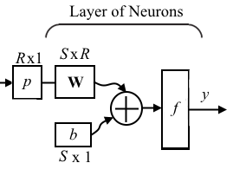

Slide 23
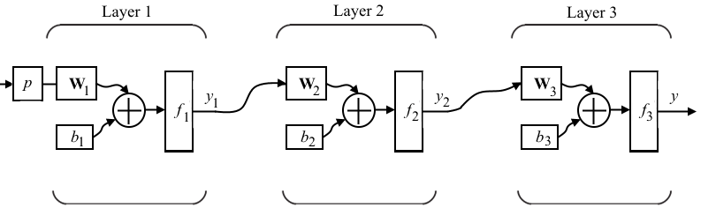

Slide 24
Learning Procedure
Training Set
p – input with corresponding output t
Validation Set
Testing Set

Slide 31
Forecast with neural nets
The forecast scheme is reduced to the classification and parameterization of a non-linear AR model with neural net training;
The order of model d (the number of previous needed observations), however, is chosen by human;

Slide 32
Nonlinear Autoregressive model
The main model for the forecast is called Nonlinear Autoregressive Model = NAR-net;
The optimization criterion is, as always, the minimization of a mean-square error;

Slide 33
Structure of NAR-net
A standard feed-forward neural net with two layers and with sigmoid activation function for a hidden layer and with linear activation function for an outer layer.

Slide 34
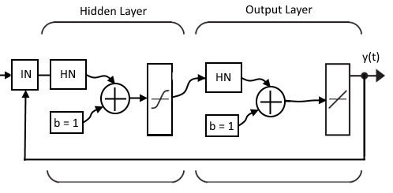

Slide 35
General NAR-forecast procedure
Chose the initial parameters for NAR-net: number of neurons for a hidden layer and model order d;
Part of time series observations is used for the training of neural net with minimization of MSE principle;
Part of time series observations is used for the testing and validation purposes with retrospective forecasting;

Slide 36
General NAR-forecast procedure
In the end, the NAR-net will estimate the coefficients for the NAR-model;
The forecast is constructed with the same recursive principle, as the simple AR-model forecast difference schemes;

Slide 37
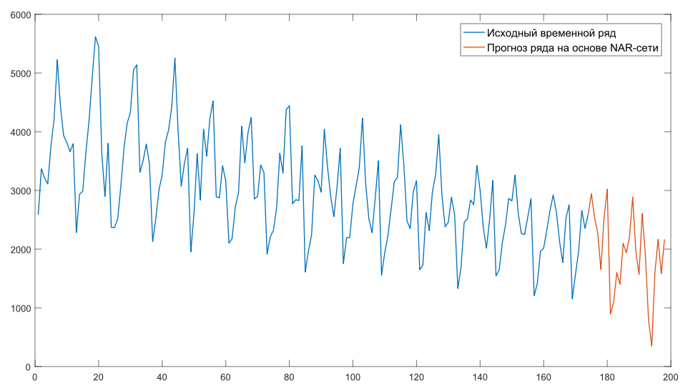

Slide 38
Definition of NARX-net
Nonlinear Autoregressive model with eXogenous inputs = NARX-net;
It has an additional input x(t), which can be used as the initial estimation of the forecast with another method;
In this case it means that the NARX-net actually works as a correction forecast scheme.

Slide 39
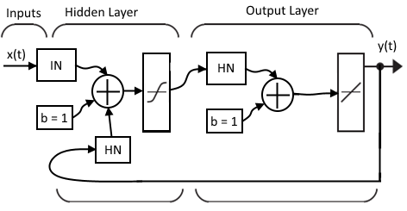

Slide 40
General NARX-forecast procedure
For a given times series y(t) the simplified model x(t) without noise is reconstructed, by any given algorithm;
Chose the initial parameters for NARX-net: number of neurons for a hidden layer and a model order d;
Train the NARX-net based on input vector x(t) with corrections from observations y(t), delayed by the d lags;

Slide 42
Part 3. Forecast correction with Data Assimilation Technique

Slide 43
Forecast correction
All of the discussed correction methods were based on the initial one-dimensional schemes;
The correction procedure was based on the weighting coefficients within forecast model;
Often we have another forecast problem: the multi-dimensional evolution model, but with one-dimensional observation time series;
How to correct this type of forecast?

Slide 44
Data Assimilation
Data Assimilation (DA) technique methods solve this problem: correction of multi-dimensional forecast with one-dimensional observation time series vector;
Also, DA methods establish the single-valued correspondence between multi-dimensional space of solutions for a forecast model and one-dimensional vector of observations;

Slide 45
Initial model representation:
where x_{k} – is the known initial state of model at time point t_{k}; x_{k+1} – state of model at the next time point; M – transition matrix or function, defining the evolution of system with time; w_{k} – noise or error in the model; y_{k} – vector of observational data; H – observation matrix or function, juxtaposing multi-dimensional state of model with one-dimensional vector of observations; v_{k} – observation error.

Slide 46
Data Assimilation
These two errors/noises are uncorrelated;
The first equation is called a forecast equation;
The second – an observation equation;
Hence, there are two steps in DA method:
Analysis step;
Forecast step.

Slide 47
Analysis step
At time t_{k} we have an initial assumption of model state x_{k}^{f}. It will serve as our background. Starting from this background we reconstruct the corrected model state x_{k}ª (known as analysis), based on the observation data y_{k} at time point t_{k}:

Slide 48
Forecast step
In the forecast step we estimate the next system state at time point t_{k+1} using our knowledge of the system evolution from time t_{k} to time t_{k+1}. Keeping in mind errors, the following estimator can be built:

Slide 49
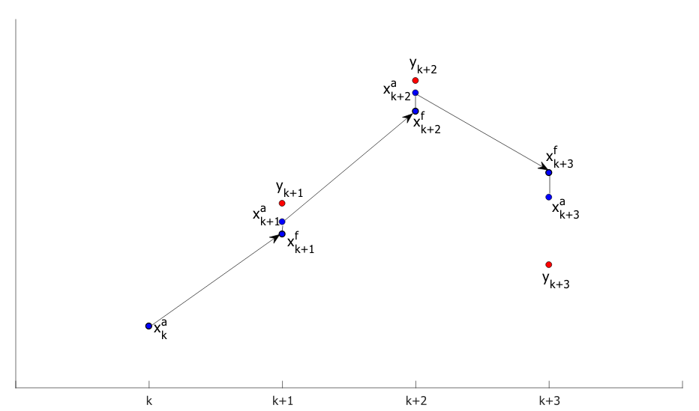

Slide 50
Linear Data Assimilation
Functions M and H can be represented as matrices, that is M(x_{k})=M·x_{k} & H(x_{k})=H·x_{k}.
In this case the Kalman gain K is simply:
where
This type of methods is called Kalman Filtering.

Slide 51
Ensemble Data Assimilation
In most cases functions M and H cannot be represented as matrices or elementary functions;
Furthermore, the covariance matrices of error are also unknown;
We need to estimate almost everything;
This type of methods is called Ensemble Kalman Filters (EnKF Data Assimilation techniques)

Slide 52
General SEnKF technique
The Stochastic Ensemble Kalman Filter = SEnKF
Draw a statistically consistent observation set
and compute the empirical error covariance matrix

Slide 53
General SEnKF technique
Compute the Kalman gain, where instead of matrix product we calculate the following estimations:

Slide 54
General SEnKF technique
Compute the ensemble of analyses x_{i}ª.
Compute the ensemble forecast for each x_{i}ª and their expectation forecast value:
Compute the forecast error covariance matrix, needed for the next time point:

Slide 55
References
Golyandina N., A. Zhigljavsky. Singular Spectrum Analysis for time series. — Springer Briefs in Statistics. — Springer. — 2013. — 120 p. ISBN 978-3-642-34912-6.
MathWorks Center. NARX Network. Design Time Series NARX Feedback Neural Networks. (https://www.mathworks.com/help/nnet/ug/design-time-series-narx-feedback-neural-networks.html)
Marc Bocquet. Introduction to the principles and methods of data assimilation in geosciences. Lecture notes. — Ecole des Ponts ParisTech. — 2015. — 88 p.
G. Evensen. The ensemble kalman filter: theoretical formulation and practical implementation. Ocean Dynamics. — 2003. — vol. 53, pp. 343–367.

